Slide 1
Under 16 Cancer Patient Experience Survey
2025 communications toolkit for fieldwork period

Slide 2
Contents
About this toolkit
Communications messaging
Communications assets

Slide 3
About this toolkit
What is this toolkit?
This communications toolkit is designed to help you raise awareness of the survey and encourage those who are invited to take part to respond. It provides a range of assets you can use to help spread the word about the survey and encourage participation.
This toolkit is designed to help with the communication and promotion of the 2025 Under 16 Cancer Patient Experience Survey (U16 CPES) during the fieldwork period (April to June 2026).
All communication materials are available to download at Survey support materials | U16 Cancer Survey.
Why is it important to promote the survey?
Additional promotion of the survey can help encourage people to take part when they have been invited. It is important that as many people as possible respond to the survey so that the results reflect the views of cancer patients.
Patients who will be invited to take part in the 2025 survey are children under 16 who received NHS cancer care in England during 2025 and their parents or carers.
The survey is sent out to eligible patients around 14 April, with reminders sent in May, and the survey closes at the end of June. Therefore, the months of April, May and June 2026 are a key opportunity to promote the survey to patients.
There was a substantial reduction in response rate to the survey since the survey was first run in 2020, therefore we strongly encourage you to use this toolkit to raise awareness of the survey to help maximise response rates.
If you have any questions on the information in this document or would like guidance on communications, please contact under16cancersurvey@pickereurope.ac.uk.

Slide 4
How to use this toolkit
Who can I share the toolkit with?
This toolkit can be shared with different teams who may be in contact with eligible cancer patients and their parents/carers during the fieldwork period (April to June 2026).
If you work in a trust, you could get in touch with your engagement/comms teams or Operational Delivery Networks (ODNs) to see how they can support with promoting the survey.
Please also consider sharing this toolkit or messaging within the toolkit with your colleagues in patient facing roles. For example:
How should the toolkit be used?
To reach the audience of cancer patients, it is likely that most communication will be carried out by Principal Treatment Centres who provided treatment to eligible patients in 2025.
Please consider different touchpoints with patients, for example if you share communications with patients via an app, face-to-face or letters, there are different resources in this toolkit that can be used and adapted for these purposes. The materials can be used online or printed (in colour or greyscale).
This toolkit is a guide and it's understood that you will adapt the content as needed to best communicate with different audiences. Please ensure you do not change the core messaging.
Patient engagement or experience teams
Macmillan Information Centre
Communications teams
Departments that interact with eligible patients during this period (e.g., radiology, haematology, surgical, diagnostic)
Local cancer support groups and charities

Slide 5
Communications messaging

Slide 6
About the U16 CPES
This summary can be used to describe the Under 16 Cancer Patient Experience Survey and its purpose.
What is the Under 16 Cancer Patient Experience Survey?
The Under 16 Cancer Patient Experience Survey measures the experience of children and young people under the age of 16 in care and treatment for cancer. This survey builds on the success of the National Cancer Patient Experience Survey but recognises that cancer care pathways and care priorities for children often differ to adults, and therefore a unique approach is required to understand their experiences of cancer care and treatment.
The results from the survey provides national-level insight into the experiences of children with cancer and will inform how the NHS delivers cancer services going forward.
The surveys will be sent by post in April 2026 to those who received cancer-related care and treatment in 2025, with the results due for release in autumn 2026. NHS England are working with Picker to deliver this survey. For more information, visit www.under16cancerexperiencesurvey.co.uk.

Slide 7
Key messages
Here are some key messages about the Under 16 Cancer Patient Experience Survey.
The Under 16 Cancer Patient Experience Survey (U16 CPES) measures the experiences of NHS tumour and cancer care in children across England.
The Under 16 Cancer Patient Experience Survey informs how the NHS delivers cancer services with the aim to improve the outcomes for children and young people affected by cancer.
Those working within cancer services will use the results to assess performance both locally and nationally, to help identify priority areas for improving the experience of children’s cancer services.
Experience of care for people who use NHS services is extremely important and we understand the need for personalised care and treatment. By contributing to the survey, you will help the NHS to continue to improve services.

Slide 8
Bulletin / newsletter copy
Please consider using the following copy in your bulletins or newsletters that are shared with patients or their parents and carers.
Short version
A diagnosis of childhood cancer understandably has a devastating impact on the emotional health and wellbeing of the child and their family, both during and after treatment.
It’s so important for us to listen and learn from children and young people to provide them with the best possible care and experience throughout treatment and to reduce the impact it has on them later in life.
The Under 16 Cancer Patient Experience Survey informs how the NHS delivers cancer services with the aim to improve the outcomes for children and young people affected by cancer. The NHS really wants to hear from children and young people, and their families, about their experiences so that we can continue to improve the care and services the NHS delivers. If you receive an invitation in the post, please complete the survey.
For more information visit www.under16cancerexperiencesurvey.co.uk.

Slide 9
Bulletin / newsletter copy
Long version
A diagnosis of childhood cancer understandably has a devastating impact on the emotional health and wellbeing of the child and their family, both during and after treatment. It’s so important for the NHS to listen and learn from children and young people to provide them with the best possible care and experience throughout treatment and to reduce the impact it has on them later in life.
We want to hear from children and young people, and their families, about their experiences so that we can continue to improve the care and services the NHS delivers.
The Under 16 Cancer Patient Experience Survey builds on the work of the National Cancer Patient Experience Survey, understanding that cancer care pathways and care priorities for children and young people often differ to adults.
The survey has been running since 2020 and the results provide national-level insight into the experiences of children with cancer and informs how the NHS delivers cancer services going forward. Commissioners, providers, and national policymakers use the results to assess performance both locally and nationally, to help identify priority areas for enhancing children’s cancer services. The aim is to improve the outcomes for children and young people affected by cancer.
The survey is being run for the sixth time across England from April 2026. Children under 16 who received NHS cancer care during 2025 and their parents or carers will be invited to participate. They will be able to complete a paper questionnaire or an online version of the survey on any device.
Experience of care for people who use our services is extremely important, and the need for personalised care and treatment is well recognised. By contributing to the survey, young people and their parents or carers will help the NHS to continue to improve its services and better support children and young people living with and beyond cancer. If you receive an invitation in the post, please complete the survey.
For more information on the survey visit www.under16cancerexperiencesurvey.co.uk
​

Slide 10
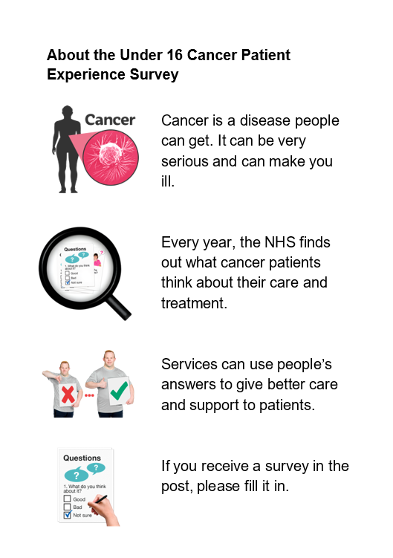
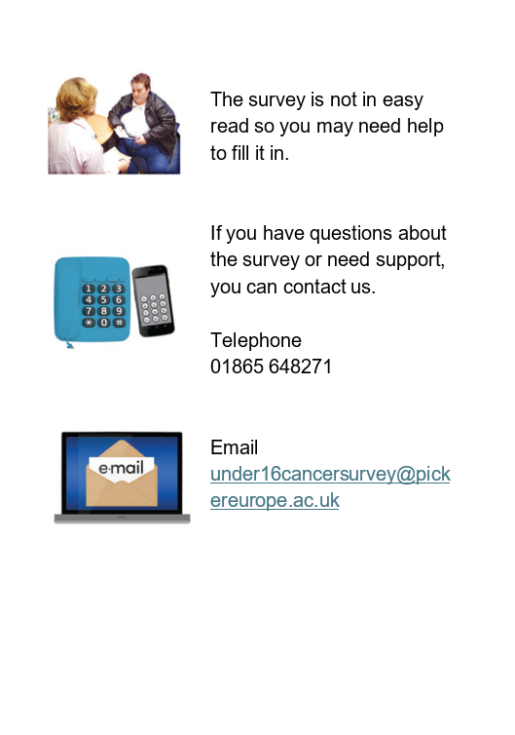
Easy read messaging
This easy read information can be shared to encourage completion of the survey. The information can be downloaded here.

Slide 11
Internal comms
Please consider sharing this messaging with your colleagues internally to help with promotion of the survey. This could be shared on your staff intranet or internal newsletters.
Please help with promotion of the Under 16 Cancer Patient Experience Survey
The Under 16 Cancer Patient Experience Survey (U16 CPES) measures the experiences of NHS tumour and cancer care in children across England. The results inform how the NHS delivers cancer services with the aim to improve the outcomes for children and young people affected by cancer.
Patients who will be invited to take part in the 2025 survey are children under 16 who received NHS cancer care in England during 2025 and their parents or carers. The survey will be sent out by post to eligible patients around 14 April, with reminders sent in May, and the survey closes at the end of June. Therefore, the months of April, May and June 2026 are a key opportunity to promote the survey to patients.
There was a substantial reduction in response rate to the survey since the survey was first run in 2020, therefore we strongly encourage you to raise awareness of the survey to help maximise response rates. Additional promotion of the survey can help encourage people to take part when they have been invited. It is important that as many people as possible respond to the survey so that the results reflect the views of cancer patients.
Please use the resources in this communications toolkit to promote the survey.
For more information visit www.under16cancerexperiencesurvey.co.uk.
​

Slide 12
Script when talking to patients
This script has been developed for NHS staff to use when speaking to patients and their parents or carers. Some feedback we have received from patient representatives is that patients are much more likely to take note of the survey if it is spoken about by their healthcare professional.
Your feedback is really important to help us deliver what patients want and need.
You may receive the Under 16 Cancer Patient Experience Survey through the post in April 2026. The survey will ask you about your experience of cancer care.
The NHS and cancer charities use the results to understand what is working well and which areas need improvement.
If you are invited, please take part and share your experiences of the care you’ve received.
Note for NHS staff on eligibility of cancer patients for the U16 CPES:
Patients with a confirmed cancer or tumour diagnosis who received inpatient or day case care from an NHS Principal Treatment Centre (PTC) in 2025, aged under 16 at their time of discharge.
Not all cancer patients will be invited as some exclusion criteria is applied to the sampling. For example, we exclude private patients, anyone known to be a current inpatient, patients solely treated at POSCUs, and patients without a UK postal address.
For more information on the survey, please visit www.under16cancerexperiencesurvey.co.uk.

Slide 13
Social media copy
Over the following pages you will find suggested copy for:
Bluesky / X (formerly Twitter)
Facebook
Instagram
LinkedIn
Alongside the wording provided, you can share assets provided in this toolkit, for example:
Social media cards
Improvement work posters
Latest results
Promotional video
When posting on social media about the survey please use the hashtag #U16CancerPatientSurvey and tag @NHSEngland.

Slide 14
Bluesky / X (formerly Twitter)
Posts for the beginning of the fieldwork period (April 2026):
We want to listen & learn from the experiences of young people diagnosed with cancer to improve the care & support the NHS provides 🤝. Take part in the @NHSEngland #U16CancerPatientSurvey to help us develop cancer services for children & young people. www.under16cancerexperiencesurvey.co.uk
To provide the best possible care for young people diagnosed with cancer, it’s important for us to listen & learn from their experiences. The #U16CancerPatientSurvey informs how we deliver cancer services. @NHSEngland www.under16cancerexperiencesurvey.co.uk.
Children aged 16 and under, cared for or treated for cancer in 2025 and their parents/carers, are being invited to take part in a survey to help improve cancer care services. @NHSEngland #U16CancerPatientSurvey www.under16cancerexperiencesurvey.co.uk.
The Under 16 Cancer Patient Experience Survey informs how the NHS delivers cancer services and aims to improve outcomes for children affected by cancer. If you receive a survey in the post, please have your say 📢 @NHSEngland #U16CancerPatientSurvey www.under16cancerexperiencesurvey.co.uk
Last year, 78% or children said they were very well looked after by staff for their cancer or tumour. If invited, have your say in the #U16CancerPatientSurvey @NHSEngland 📢
Posts to remind people to take part at the end of the fieldwork period (June 2026):
Don’t miss your chance to help inform positive change to cancer services 🤝. If invited, have your say in the #U16CancerPatientSurvey www.under16cancerexperiencesurvey.co.uk @NHSEngland
Final reminder ⏰ help contribute to future improvements in your local cancer services. If you are invited to take part in the #U16CancerPatientSurvey, have your say www.under16cancerexperiencesurvey.co.uk @NHSEngland

Slide 15
Facebook
Posts for the beginning of the fieldwork period (April 2026):
We want to listen and learn from the experiences of children diagnosed with cancer to improve the care and support the NHS provides. The @NHSEngland Under 16 Cancer Patient Experience Survey informs how we deliver cancer services for children and young people. If you receive a survey in the post, please take part. For more information, visit www.under16cancerexperiencesurvey.co.uk. #U16CancerPatientSurvey #ChildrensCancer #ChildhoodCancer
To continue to improve our services, we want to listen and learn from the experiences of children diagnosed with cancer. If invited, have your voice heard by completing the Under 16 Cancer Patient Experience Survey. For more information, visit www.under16cancerexperiencesurvey.co.uk. #U16CancerPatientSurvey #ChildrensCancer #ChildhoodCancer
Help improve cancer services for young people and have your say. Children under the age of 16 cared or treated for cancer in 2025 and their parents/carers are being invited to take part in a survey to help with the continued improvement of cancer care for young people. If you receive a survey in the post, please have your say. #U16CancerPatientSurvey www.under16cancerexperiencesurvey.co.uk. #U16CancerPatientSurvey #ChildrensCancer #ChildhoodCancer
Posts to remind people to take part at the end of the fieldwork period (June 2026):
Don’t miss your chance to help inform positive change to cancer services. The Under 16 Cancer Patient Experience Survey was sent out to those who are eligible, and will be closing soon ⏰.
​If you were invited, please don’t miss the opportunity to take part and share your experiences of care. ​The NHS and cancer charities use the results to understand what is working well and which areas need improvement.
The survey has been posted to those eligible to complete. For more information on the survey and how to access help and support in completing it, please visit www.under16cancerexperiencesurvey.co.uk #U16CancerPatientSurvey #ChildrensCancer #ChildhoodCancer

Slide 16
Instagram
Instagram stories
Story one - Childhood cancer has a devastating impact on the emotional health and wellbeing of the child and their family, both during and after treatment. (Link to www.under16cancerexperiencesurvey.co.uk)
Story two - Children’s treatment and experience of cancer differs greatly from adults, and we recognise the need for a personalised approach to children’s cancer care. (Link to www.under16cancerexperiencesurvey.co.uk)
Story three - The Under 16 Cancer Patient Experience Survey will inform how we deliver cancer services for children and young people. (Link to www.under16cancerexperiencesurvey.co.uk)
Story four - If you receive a survey in the post, please have your say and help us improve our services. (Link to www.under16cancerexperiencesurvey.co.uk)
Instagram post
A childhood cancer diagnosis understandably has a devastating impact on the emotional health and wellbeing of the child and their family, both during and after treatment.
We want to listen and learn from the experiences of children diagnosed with cancer to improve the care and support the NHS provides. The Under 16 Cancer Patient Experience Survey will help us understand and develop our cancer services for children and young people in line with their needs.
If you are invited, you will receive a survey in the post. Please have your say. #U16CancerPatientSurvey

Slide 17
LinkedIn
The @NHSEngland Under 16 Cancer Patient Experience Survey helps us to understand and improve the care and experience for children under the age of 16 in care and treatment for cancer.
The results from the survey will provide national-level insight into the experiences of children with cancer and inform how the NHS delivers cancer services going forward. The aim is to radically improve the outcomes for children and young people affected by cancer.
Children who received cancer-related care and treatment in 2025, and their parents or carers, will receive a survey in the post from April 2026. For more information, visit www.under16cancerexperiencesurvey.co.uk.
#Under16CancerPatientSurvey

Slide 18
Communications assets

Slide 19

Promotional quote cards
Promotional quote cards can be shared alongside social media posts. The cards can be downloaded here.
These quote cards have been produced by cancer patients and those who use the survey data. In their own words, they talk about why U16 CPES is important. ​
The individuals have given permission for their quote cards to be used to promote the survey.

Slide 20

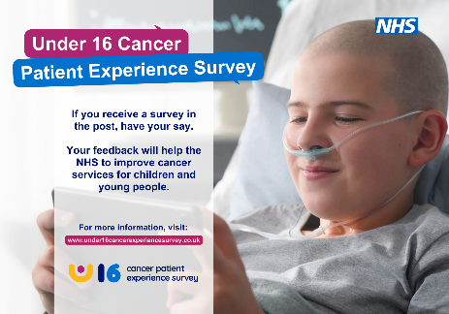



Social media cards
These social media cards can be shared alongside social media posts. There are versions in different sizes suitable for different platforms. Social media cards can be downloaded here.

Slide 21





Posters
Please consider displaying these posters in areas that are visible to patients and their parents/carers, such as children’s cancer wards and waiting rooms. You can print them in colour or greyscale. You can also display them online, for example on your website, social media or screens in waiting areas. Posters can be downloaded here.
Please note that these posters are separate from the ‘dissent posters’ which must be displayed. The purpose of the dissent posters is to provide an opportunity for patients to opt-out of receiving the survey.

Slide 22


Leaflets for children/young people
These leaflets are included in the mailing packs for 8 to 15-year-olds.
The leaflets can be downloaded here.
Version for 8-11 mailing pack:
Version for 12-15 mailing pack:

Slide 23
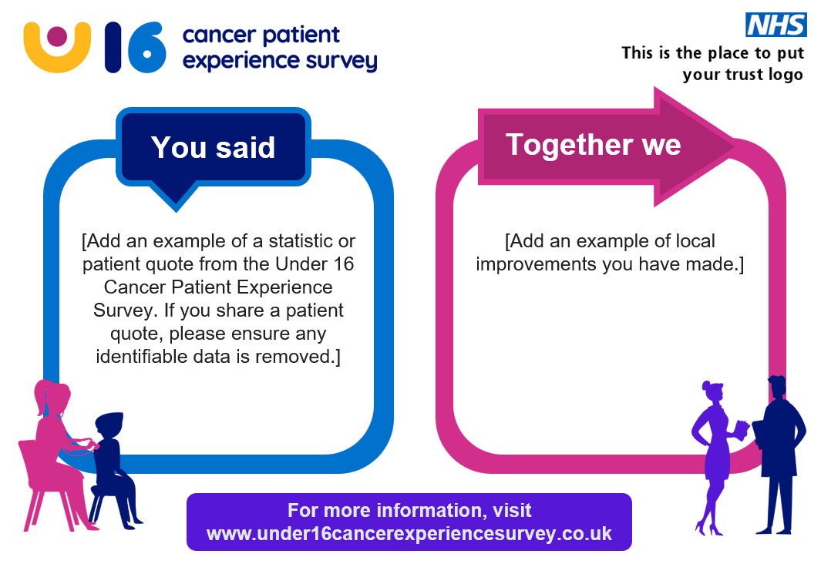
Improvement work posters
We have created a poster template for you to add examples of local improvement work to demonstrate the impact of the survey. The poster template and guidance can be downloaded here.
We often hear from patients that demonstrating the value of U16 CPES is key. Patients want to know how their feedback has been used. These posters can be used to encourage participation in future surveys.

Slide 24


Banner / letter footer
This banner can be used to promote the survey. It can be used for different purposes such as on your website, your local app or in your email signature. The banner can be downloaded here.
This letter footer can be used to promote the survey. It can be used for different purposes such as a footer on printed letters sent to patients or in your email signature. The footer can be downloaded here.

Slide 25
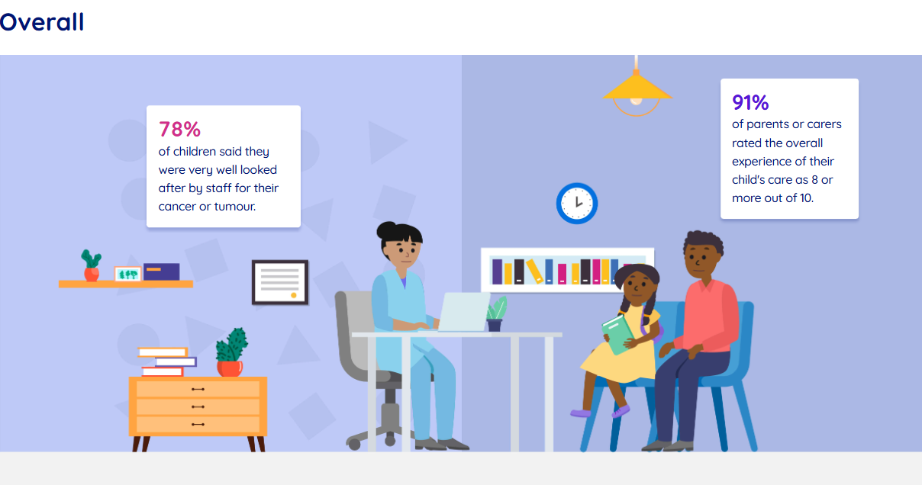
Latest results
There are national result visual summaries and social cards that show the 2024 results, which can be used to encourage patients to complete this year’s survey. The files can be viewed here.

Slide 26

Promotional video
This video can be used to encourage patients to take part in the survey. It can be used on social media or displayed on TV screens in hospital waiting rooms.
The video is available to download here.

Slide 27

Logo
The Under 16 CPES logo can be used alongside blog and newsletter copy or any other information to promote the survey. The logo is available to download here.

Slide 28
Thank you
For questions about the survey, please refer to the Under 16 Cancer Patient Experience Survey website: https://www.under16cancerexperiencesurvey.co.uk/faq
If you questions about this toolkit, please contact: england.insight-queries@nhs.net

